Slide 1
Job Analytics Tool
CLI Based Data Analysis System
- By -
Dhananjay Bilade
Python Development Internship
- from -
CS Vision

Slide 2
About the project
What is this project ?
The Job Analytics Tool is a Python-based CLI application developed to analyze job datasets and generate meaningful insights using statistical analysis and data visualization techniques.
Main Purpose:
Analyze job market trends
Study salary distribution
Visualize hiring pattern
Understand relationship between experience and salary

Slide 3
Project objectives
Perform data cleaning and preprocessing
Analyze salary statistics
Generate meaningful visualizations
Identify job trends by category and location
Build a CLI-based analytics tool

Slide 4
Technology stack
Technology
Purpose
Python
Core Programming
Pandas
Data Processing
NumPy
Statistical Analysis
Matplotlib
Visualization
Seaborn
Advanced Charts

Slide 5
Project Methodology
Dataset Collection
Data Cleaning
Preprocessing
Statistical Analysis
Visualization
Insights & Results
CSV dataset containing job-related information
Handling missing values and formatting data
Make CSV dataset ready for analysis
Salary statistics and category analysis
Charts generated using Matplotlib and Seaborn

Slide 6
Key features
Salary Distribution Analysis
Jobs per Category
Jobs per Location
Experience vs Salary
Monthly Hiring Trends
CLI Menu-based Interface

Slide 7
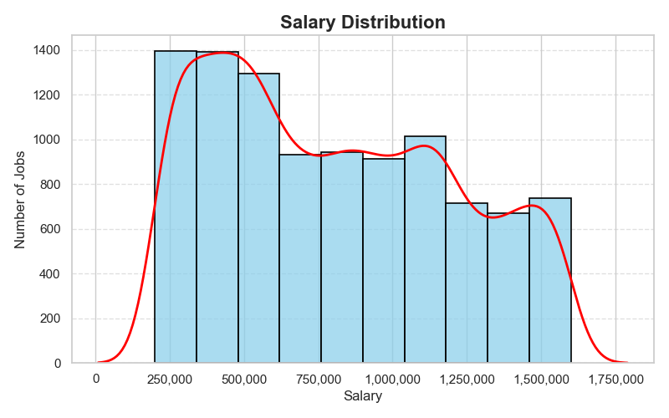
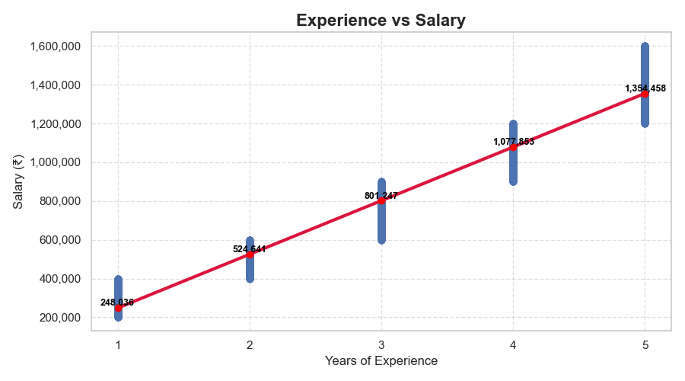
Charts and graphs
Salary Distribution
2. Experience vs Salary
Shows salary spread and density trend
Shows positive relationship between experience and salary

Slide 8
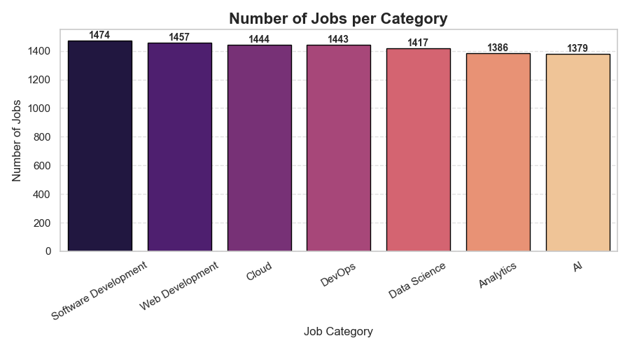
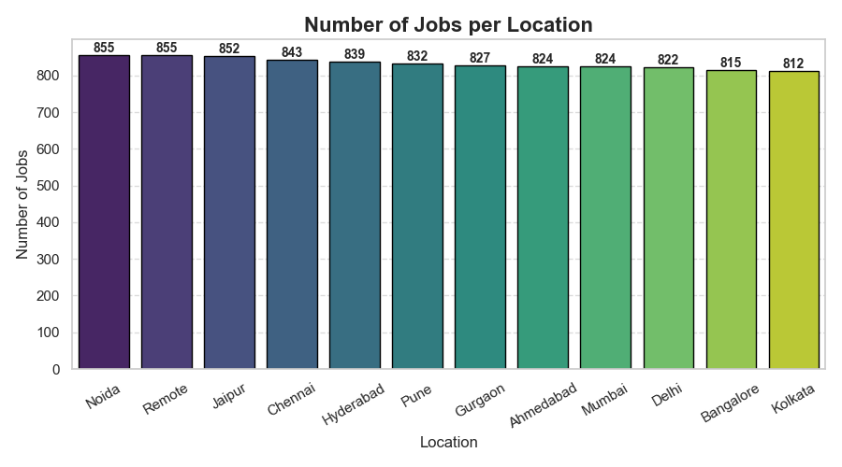
Charts and graphs
3. Jobs per Category
4. Jobs per Location
Identifies most demanding job domains
Shows geographical hiring trends

Slide 9
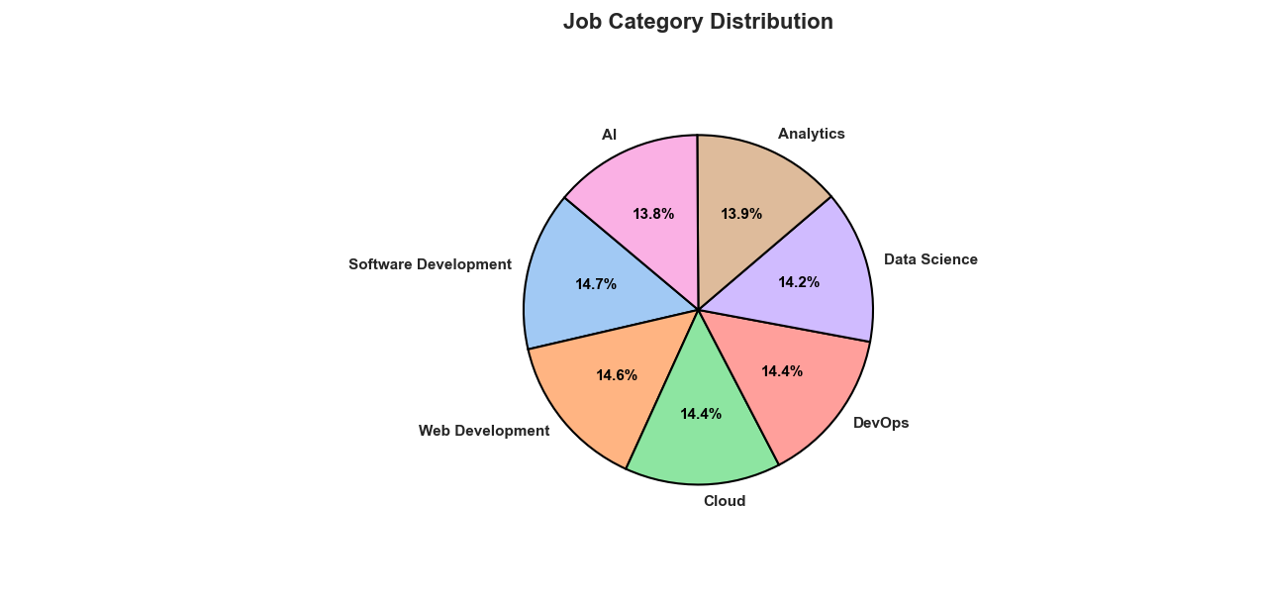
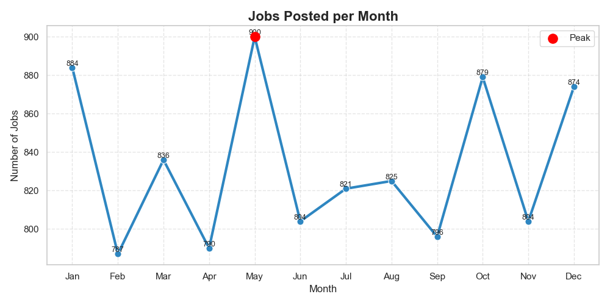
Charts and graphs
5. Job Category Distribution
6. Jobs Posted per Month
Shows percentage wise distribution of job categories
Displaying hiring activity over time

Slide 10
Project outcomes
Successfully analyzed job dataset
Generated meaningful insights
Visualized salary and hiring trends
Built modular Python application
Improved understanding of data analytics workflow
LeARNING outcomes
Data preprocessing using Pandas
Statistical analysis using NumPy
Visualization using Seaborn & Matplotlib
Debugging and problem solving
Building modular Python projects

Slide 11
Conclusion
The project successfully demonstrated how Python can be used for data cleaning, analysis, and visualization. It Improved practical understanding of data analytics workflows and enhanced problem-solving skills.

Slide 12
Thank you

